Slide 1

Last-Mile Delivery Operations Analytics

Slide 2


About Me
NANGUNOORI SRIJA
Background: B.Tech - CSE, specializing in Artificial Intelligence & Machine Learning (AIML)
Why Data Science: To turn data into evidence-based decisions and solve real business problems
Experience: Fresher
LinkedIn:
GitHub:

Slide 3
Table of Contents
Project Overview
Business Scenario
Business Objectives
Dataset & Database Overview
ER Diagram & Database Structure
Analysis of the Objectives
Overall Key Findings
Business Recommendations
Conclusion
Q&A

Slide 4
Project Overview
QuickRoute Logistics is a last-mile delivery company that delivers orders to customers across many delivery zones using its own drivers and vehicles. This project builds a MySQL database from five tables (customers, orders, deliveries, drivers and vehicles) and loads and verifies the data from the CSV files. Using SQL, it analyses delivery demand, customer behaviour, delivery performance, driver and vehicle performance, and delivery problems. The results are turned into clear business insights for the Operations team. The aim is to show where service can improve and to support better, data-driven decisions.

Slide 5
Business Scenario
QuickRoute Logistics delivers parcels from its depots to customers across several delivery zones, and the last stretch to the customer’s door is the hardest and costliest part of the journey. The company serves both Individual and Business customers, with different service types and priority levels, using its own drivers and vehicles. Each order, delivery, driver and vehicle generates data, but this data has not yet been analysed in a structured way. Leadership needs to know where demand comes from, how reliable deliveries are, and why some deliveries fail or need repeat attempts. As the Data Analyst supporting the Operations team, the task is to answer these questions with SQL and to recommend actions that improve delivery performance.

Slide 6
Business Objectives
1
Understand Delivery Demand - Where and how delivery orders are generated
2
Understand Customer Order Behaviour - How customers use the delivery service
3
Evaluate Delivery Performance - How well deliveries are completed
4
Understand Driver and Vehicle Performance - How resources are used and how they perform
5
Identify Delivery Problems - Why some deliveries need extra effort or fail

Slide 7
Dataset & Database Overview
Table | Rows | Cols | What it stores
customers | 400 | 7 | Name, city, delivery zone, preferred time slot, customer type, account date
orders | 3,000 | 8 | Customer, order date, zone, package weight, service type, priority, value
deliveries | 3,500 | 10 | Order, driver, vehicle, dates, status, attempt, distance, duration
drivers | 80 | 6 | Name, hire date, rating, employment type, active status
vehicles | 50 | 7 | Type, fuel type, payload, depot, last service date, active status

Slide 8
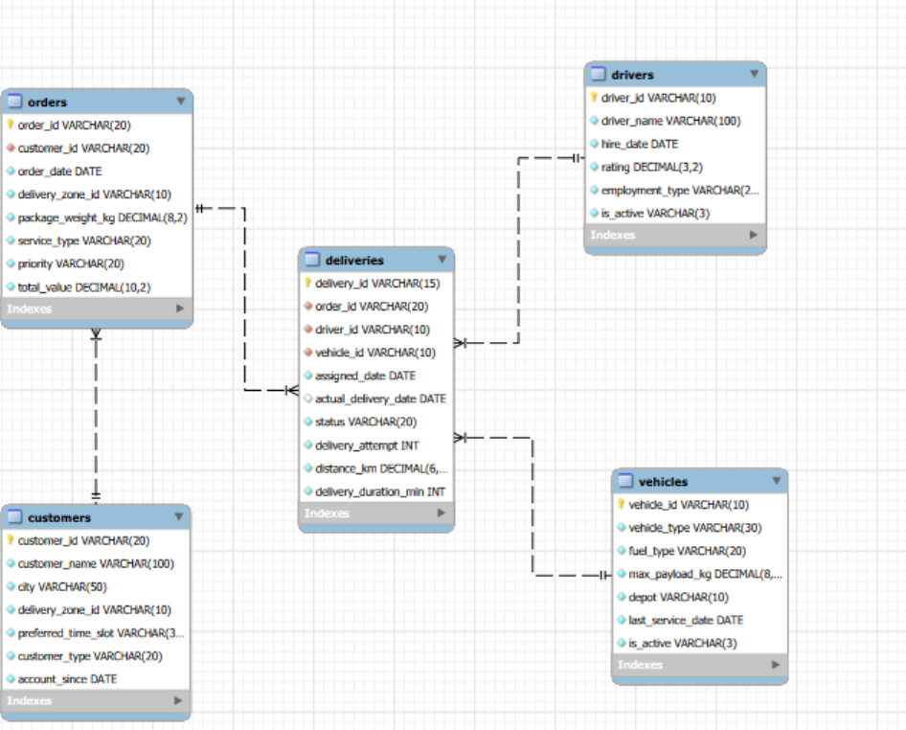
ER Diagram & Database Structure

Slide 9
ER Diagram & Database Structure
Relationships
Customers and Orders (1:M): a customer can place many orders, but each order belongs to one customer.
Orders and Deliveries (1:M): an order can have more than one delivery attempt, but each delivery record belongs to one order.
Drivers and Deliveries (1:M): a driver can handle many deliveries, but each delivery has one driver.
Vehicles and Deliveries (1:M): a vehicle can be used in many deliveries, but each delivery uses one vehicle.
Orders and Drivers (M:N): an order can be handled by different drivers across attempts, and a driver can handle many orders. The link is through the deliveries table.
Orders and Vehicles (M:N): an order can involve different vehicles across attempts, and a vehicle can be used for many orders. The link is through the deliveries table.

Slide 10
Analysis of the Objectives
Understand Delivery Demand
ZONE0005 has the most orders (240); ZONE0007 has the fewest (79).
ZONE0005 also has the highest total order value.
Standard has the most orders (620); Same Day has the fewest (582).
Next Day brings the highest total value; Same Day has the highest average order value.
Orders grew from 608 in 2022 to 1,163 in 2023 and 1,229 in 2024.
High, Normal and Urgent priorities are almost equal (1,035 / 993 / 972).

Slide 11
Analysis of the Objectives
Understand Customer Order Behaviour
Eric Davis placed the most orders (19) and has the highest total order value (43,779.25).
Individual customers place most of the orders (2,050 against 950 for Business).
Business customers have a higher average order value (2,572.70 against 2,477.24).
ZONE0005 has the most customers (29); ZONE0015 has the fewest (11).
Ordering customers grew from 246 in 2022 to 366 in 2023 and 371 in 2024.

Slide 12
Analysis of the Objectives
Evaluate Delivery Performance
73.7% of deliveries are Delivered; 9.1% are Rescheduled, 8.7% Pending and 8.4% Failed.
ZONE0010 has the best delivery rate (79.3%); ZONE0020 has the lowest (68.3%).
ZONE0003 has the highest share of failed deliveries (11.9%).
An average delivery takes 47.19 minutes (shortest 5, longest 90).
Failed deliveries take longer (49.67 min) than Delivered ones (46.92 min).
Delivery success was 74.8% in 2022 and 75.7% in 2023, then fell to 71.2% in 2024, even though delivery time improved.

Slide 13
Analysis of the Objectives
Understand Driver and Vehicle Performance
Rachel Roberts handled the most deliveries (68); Yan Lewis handled the fewest (13).
Pooja Traoré has the best success rate (89.7%); Vijay Sharma has the lowest (55.3%).
Full-time, part-time and contract drivers perform alike (73% to 74% delivered).
Cargo Bikes handled the most deliveries (717); Electric Vans handled the fewest (448).
Electric Vans have the best success rate (75.0%); Motorbikes have the lowest (71.5%).
Individual vehicles vary more than vehicle types (61.0% to 82.2% delivered).

Slide 14
Analysis of the Objectives
Identify Delivery Problems
Most deliveries succeed on the first attempt; only 4.7% need a second or third attempt.
Distance and duration rise with each attempt (about 47 min and 15.8 km at attempt 1, 50.5 min and 20.3 km at attempt 3).
ZONE0020 has the highest share of problem deliveries (31.7%); ZONE0005 has the most (69).
Problem deliveries are Failed, Pending or Rescheduled, each with its own hotspot zone.
925 orders have no delivery record.

Slide 15
Key Findings
Delivery demand is growing steadily, and a few zones generate far more orders than the others.
Service types and priority levels are used almost equally, and a large share of orders are time-sensitive.
Individual customers place most of the orders, while Business customers spend more per order.
Most deliveries are completed, but a noticeable share ends as Failed, Pending or Rescheduled.
Delivery success dropped in the latest full year, even though delivery time improved.
Performance differs by zone, and some zones have more problem deliveries than others.
Driver performance varies far more than vehicle type or employment type.
Repeat attempts are rare but involve longer distances and durations; some orders have no delivery record, which shows a tracking gap.

Slide 16
Business Recommendations
Review the weakest zones for causes such as routing, address quality and driver allocation, and copy practices from the best zones.
Reverse the recent drop in delivery success and track it regularly by zone.
Coach low-performing drivers, learn from top performers and balance workloads.
Review underperforming vehicles for maintenance and assignment issues.
Flag long-distance and heavy orders at dispatch, and confirm address and recipient before delivery to avoid repeat attempts.
Send a customer confirmation (SMS or app alert) before dispatch to reduce rescheduling and failures.
Plan capacity for busy periods and growing priority demand, promote high-value services and grow the Business segment.
Fix the data gaps and track success rate as the main KPI through a dashboard.

Slide 17
Conclusion
The analysis of 3,500 delivery records shows growing demand but inconsistent delivery reliability: 73.7% of deliveries were completed.
Performance gaps sit in specific zones, drivers and vehicles rather than in service types or employment types.
Targeted action in the weakest areas, better handling of high-risk orders and a focus on success rate would let reliability keep pace with growth.

Slide 18
THANK YOU

